Slide 1
x
1
4
3
-1
2
-4
1
0
2
-1
w
1
2
1
x
1
4
3
-1
2
-4
1
0
2
-1
w
1
2
1
x
1
4
3
-1
2
-4
1
0
2
-1
w
1
2
1
x
1
4
3
-1
2
-4
1
0
2
-1
w
1
2
1
u

Slide 2
x
1
4
3
-1
2
-4
1
0
2
-1
w
1
2
1
x
1
4
3
-1
2
-4
1
0
2
-1
12
9
3
-1
-5
-1
3
3
w
1
2
1
u = x * w
x
1
4
3
-1
2
-4
1
0
2
-1
w
1
2
1

Slide 3
x
w₁
w₂
w₃

Slide 4
x
Uniform filter
(moving average)
Gaussian filter
u
u

Slide 6
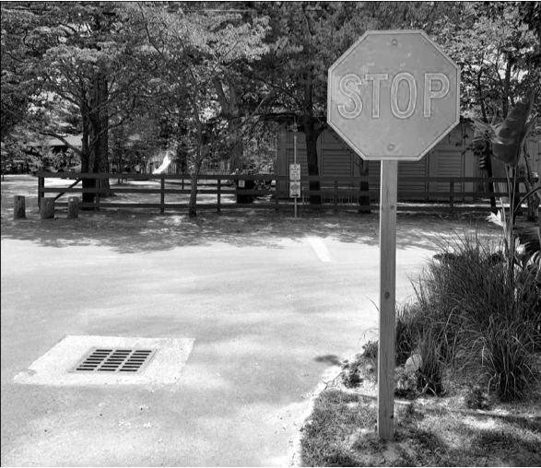
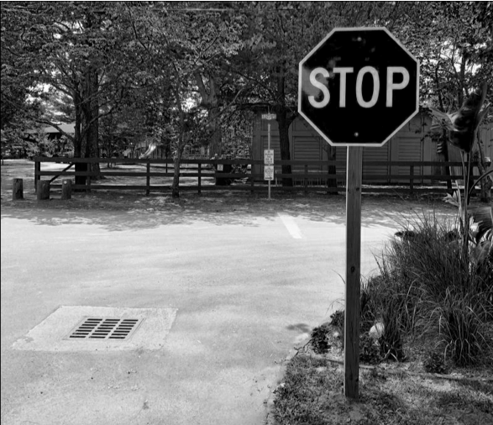
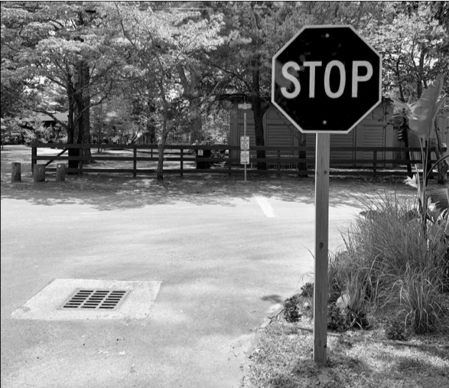
red channel
flatten
blue channel
green channel

Slide 7
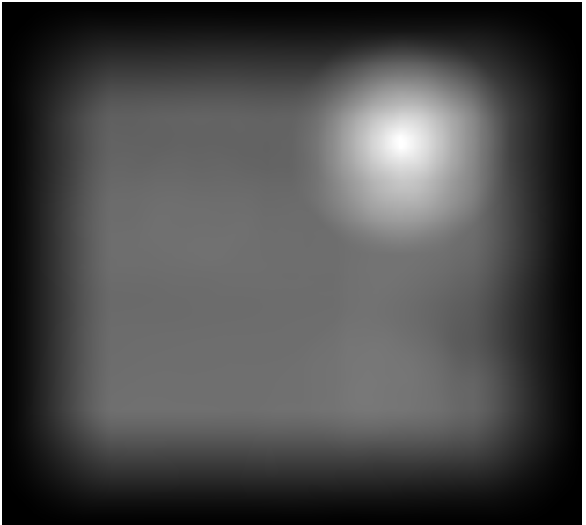

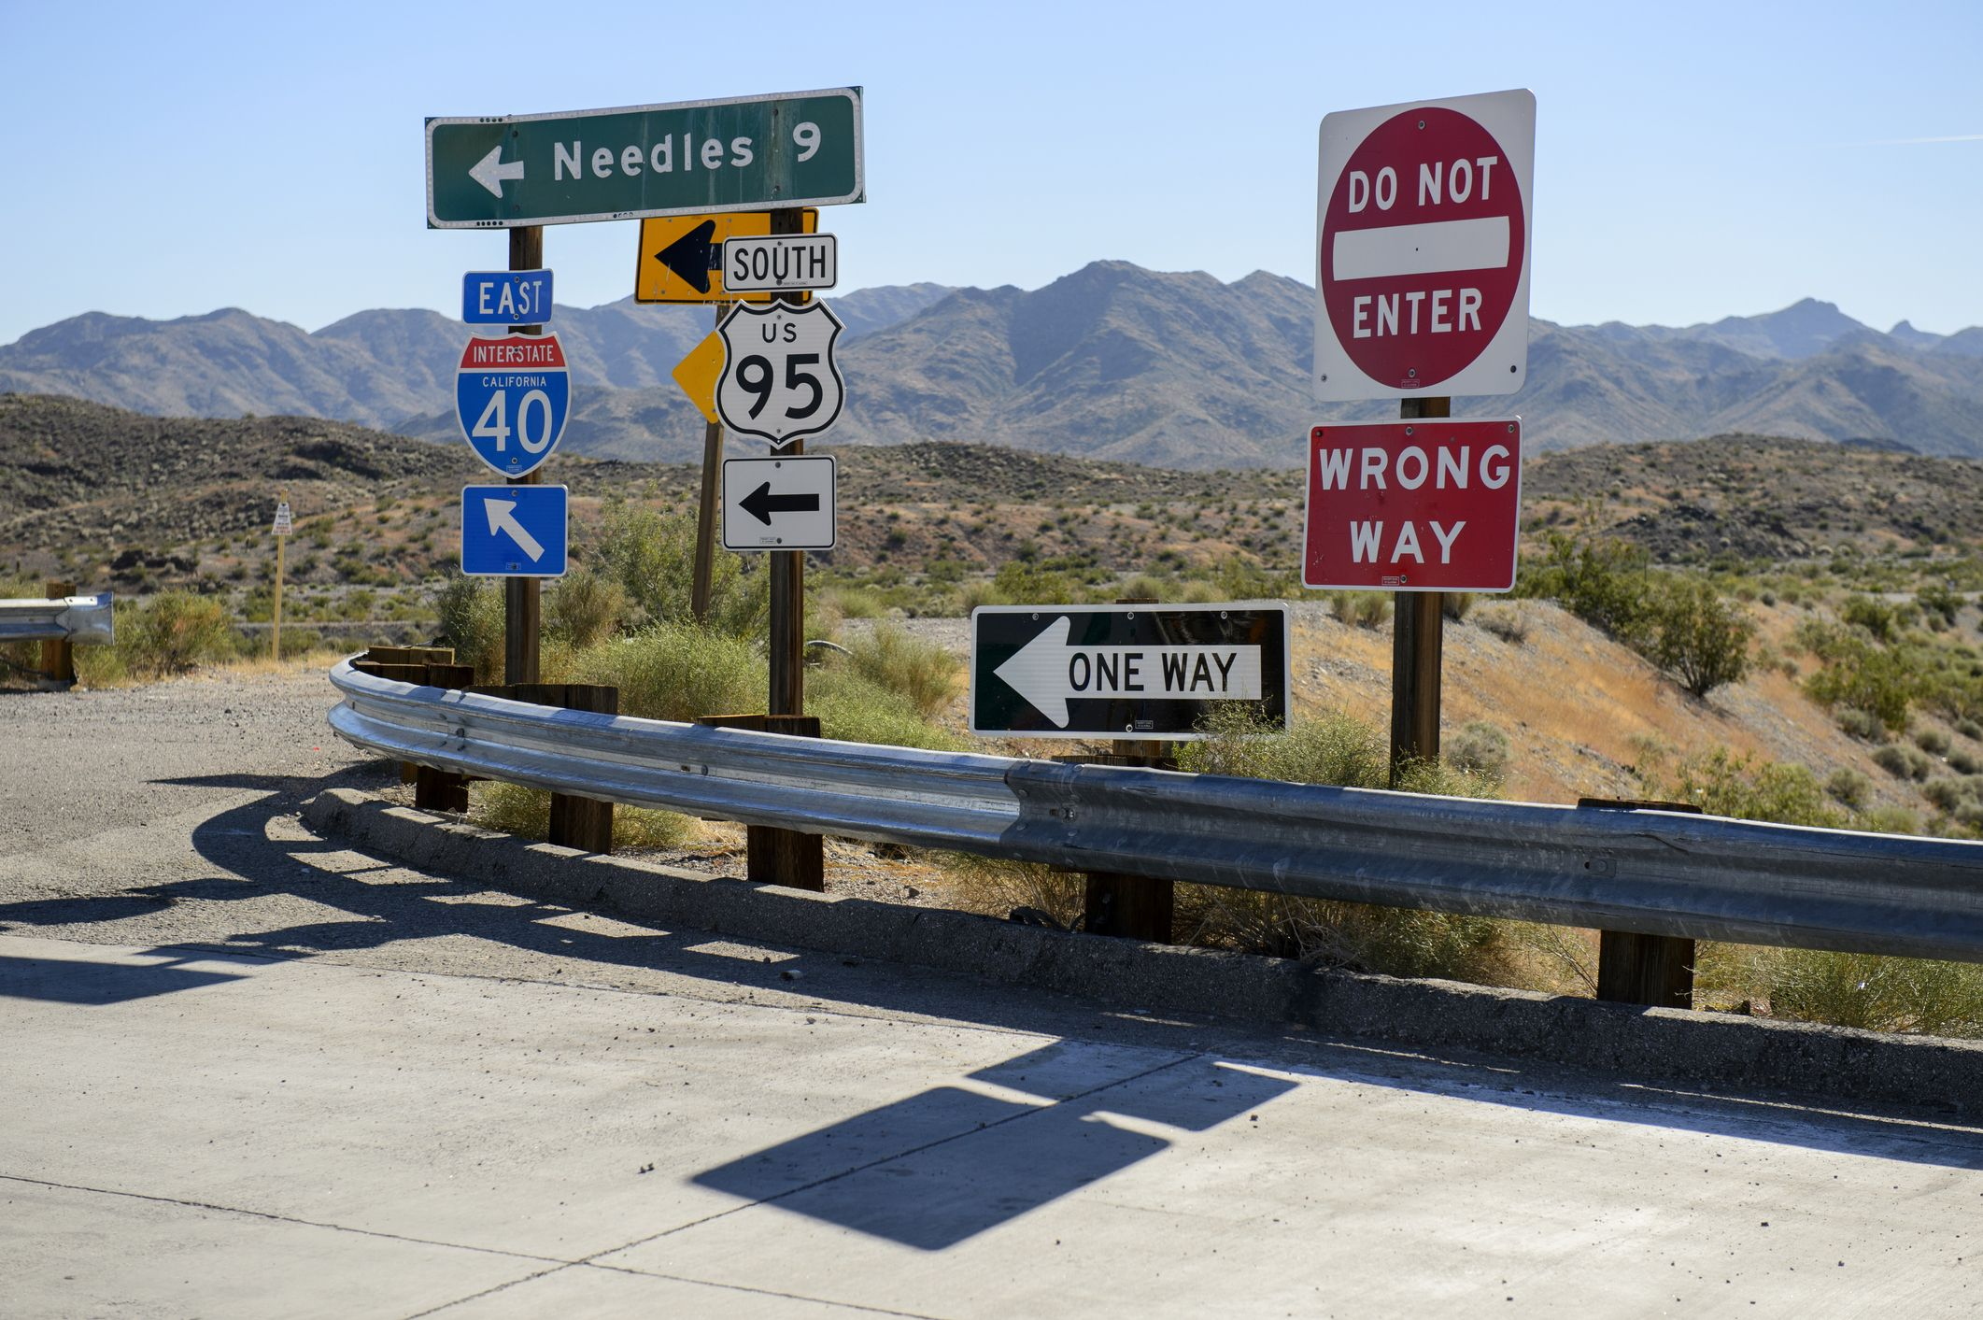
*
w
x₁
*
w
x₂

Slide 8





Slide 9
T
w
x
T
T
T

Slide 11
u₁
u₂
u₃
...
w₁
w₂
w₃
...
*
=
x

Slide 13
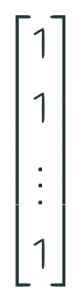
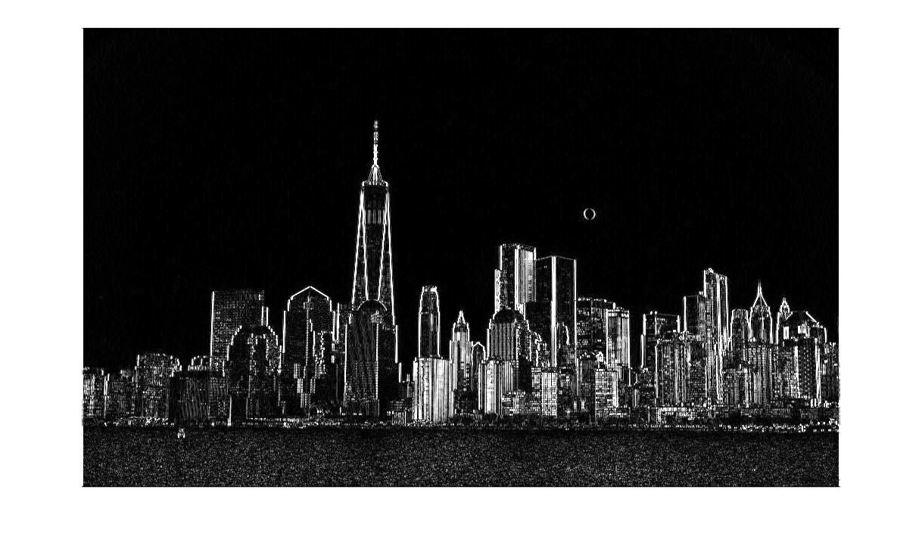
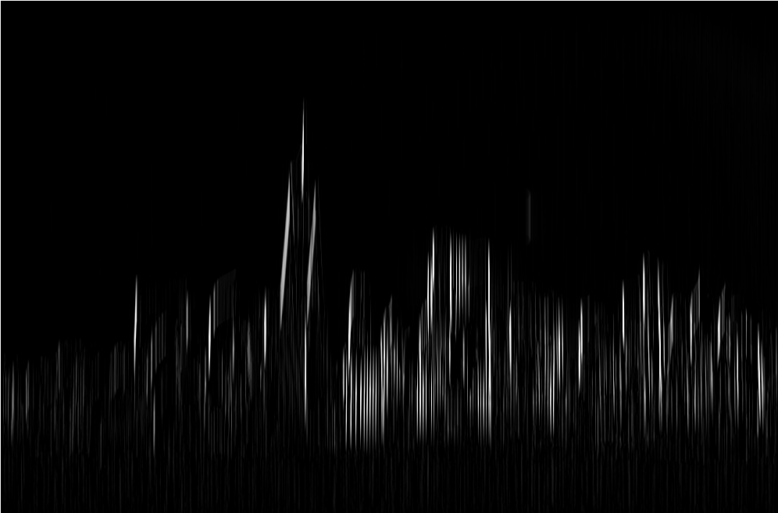
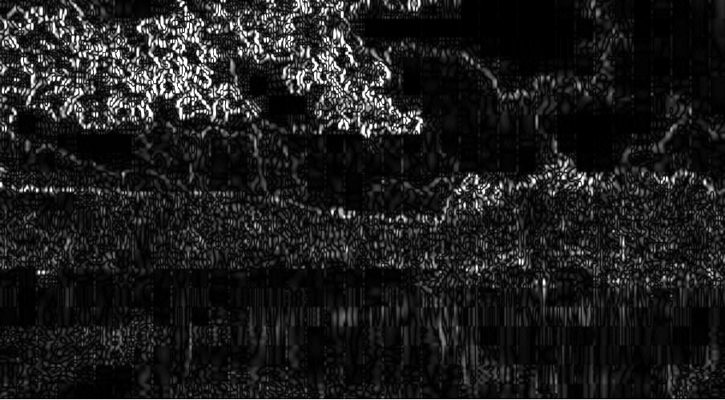
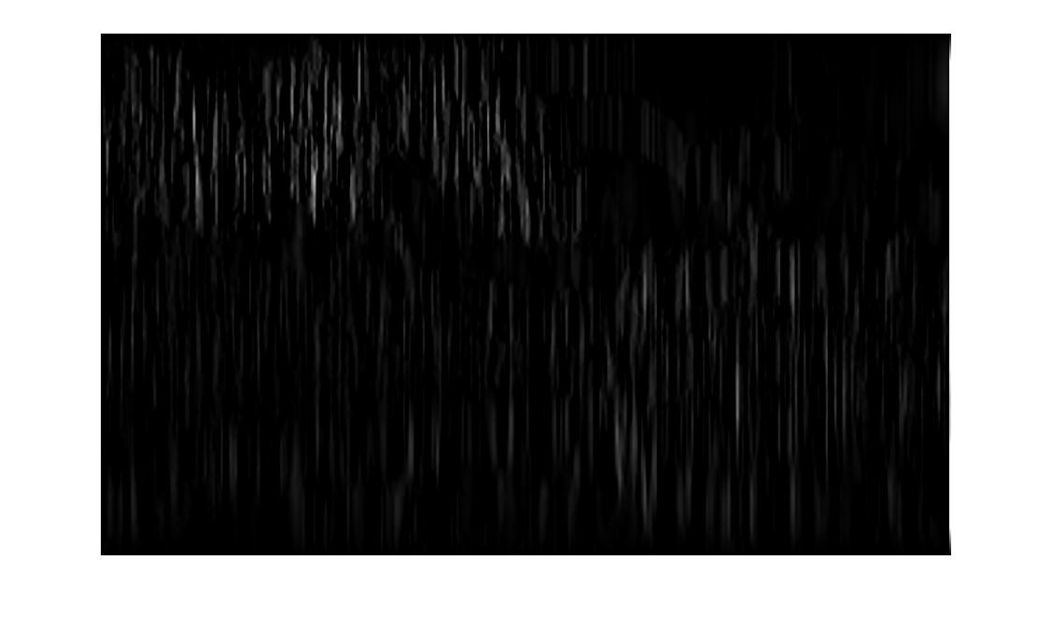
*
E_{C}
E_{C}
V_{C}
*
E_{L}
V_{L}
E_{L}

Slide 14
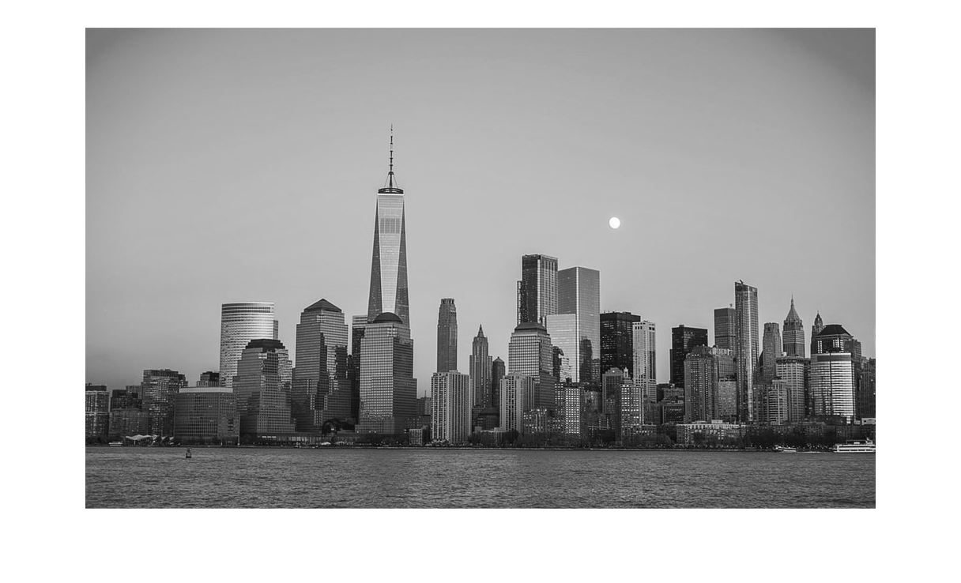
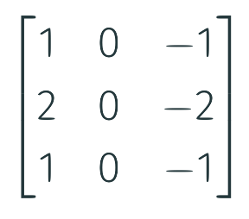
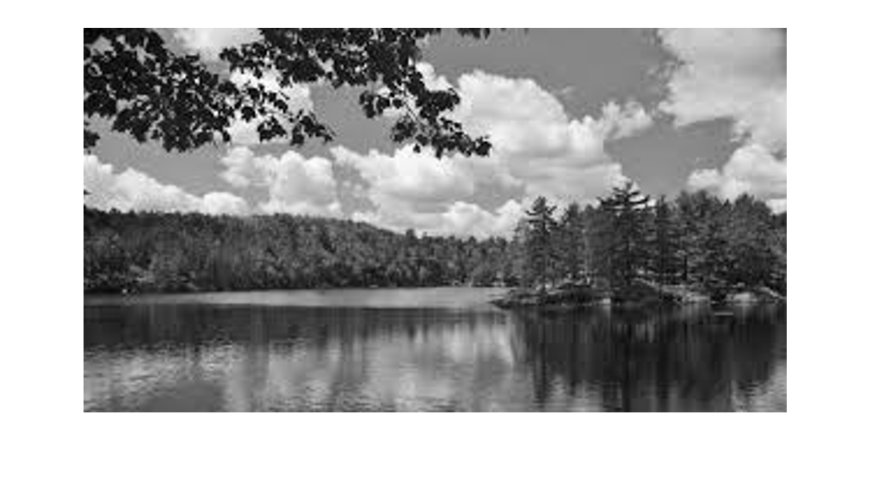
*
*
mean(V_{C})
I_{C}
E_{C}
V_{C}
*
*
mean(V_{L})
I_{L}
E_{L}
V_{L}

Slide 15
z₁
class 1
z₂
class 2
z₃
class 3
z₄
class 4
input layer
hidden layer
hidden layer
output layer

Slide 16
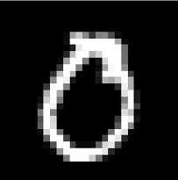
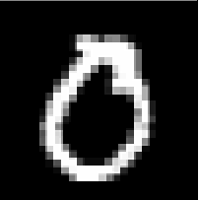
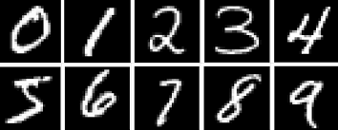
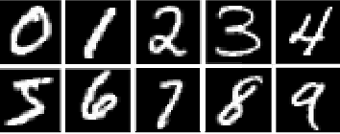

Slide 17
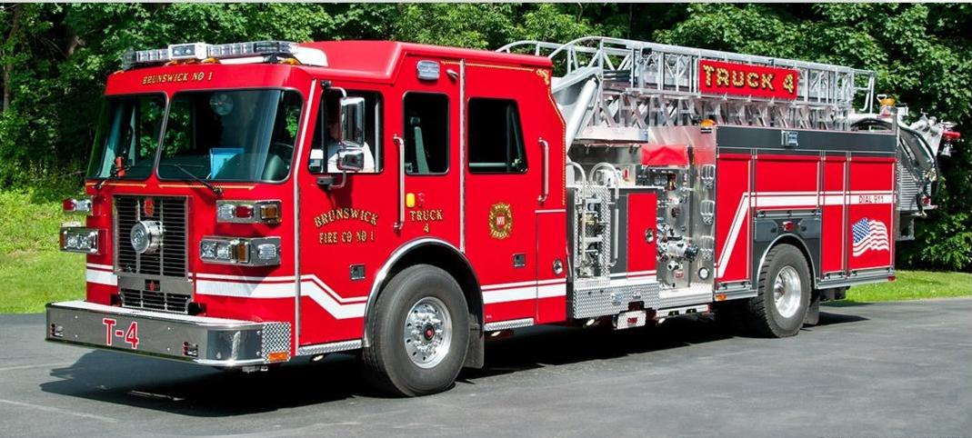


Slide 18
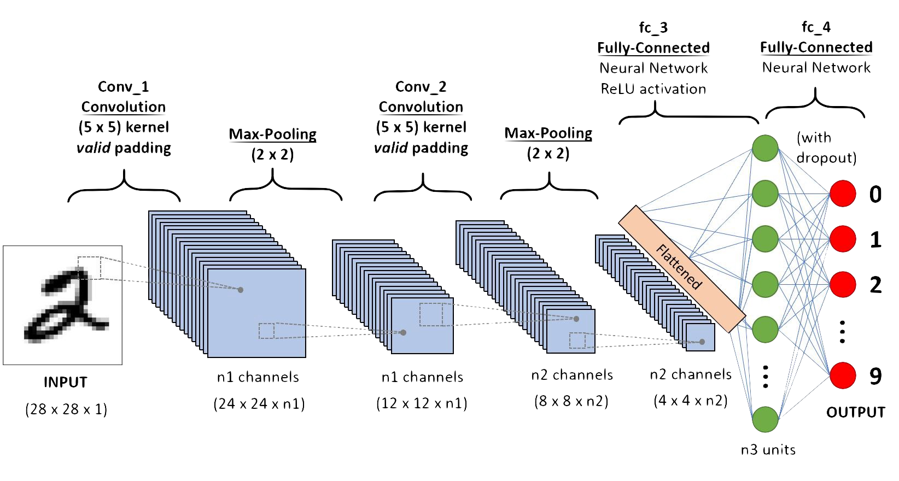
red channel
blue channel
green channel
= -1
= 0
= 1

